Slide 1
Administrative Leadership Meeting
Tuesday, July 8, 2014
Chancellor Randy Woodson
Notes:
(Chancellor opens with announcements and updates)

Slide 2
Upcoming ALM Topics
Sept. 9
Space, the Final Frontier
(Titmus Theatre)
Nov. 11
Report Card on Strategic Plan
(Titmus Theatre)
Jan. 13, 2015
Advancement Update
(Titmus Theatre)

Slide 3
Organizational
Excellence
Charles D. Leffler Vice Chancellor for Finance and Business
Notes:
(Chancellor introduces topic)
So how do we maintain and enhance our organizational excellence with these constraints? We do it by creating a culture of continuous improvement.
An excellent university is one that is pervasively excellent. Not excellent here and almost-excellent there, but one that is excellent through and through. That standard applies to everything and everyone – faculty, staff, departments, institutes, centers and units. That continuous improvement isn’t static. It requires constant attention, self-assessment and ability to change and adapt.
NC State’s Strategic Goal 4 – Enhance organizational excellence by creating culture of constant improvement.
UNC-Board of Governor’s strategic goal 4 is similar. It’s about maximizing efficiencies. We know we need to be creative - be strategic in our approach – since we have to do more with less.
The current environment is presenting additional challenges. We know that the landscape of funding for public higher education is changing. More than ever before we need to be very strategic in how we approach our resource management.
How do we think about money and how do we approach budgeting with it? What do we do with the space we have and how do we provide for the space we need? How do we deal with all the other resources we have?
These are all questions and challenges we need to address as we build upon our reputation and success as a preeminent research institution.
Vice Chancellor Leffler has an update on the nuts and bolts of our efforts to strengthen our organizational excellence.
Organizational excellence applies to administrative and academic.

Slide 4
Defining Excellence
EXPECTATIONS
ACTIONS
OPPORTUNITIES
Notes:
Defining excellence
Expectations – of others and ourselves
Actions – excellence is determined by our actions, are we meeting expectations?
Opportunities – what ideals do we have?
Challenge is speed with which we act on these – pressures from external forces, reporting requirements. Hard to achieve existing reporting requirements with new ones speeding towards us and be able to focus on setting aspirational goals and actions to achieve.
Reducing administrative cost and redirecting to core objectives but not sure where that fits.

Slide 5
ACCOUNTABILITY
PED
ASSESSMENT
STRATEGIC RESOURCE MANAGEMENT
CONSTANT IMPROVEMENT
UNC’S OUR TIME, OUR FUTURE
BAIN STUDY
EFFICIENCY
KEY PERFORMANCE INDICATORS
SHARED SERVICES
METRICS
NC GEAR
UNC FIT
EFFECTIVENESS
PROCESS IMPROVEMENT
OVERSIGHT
PACE
NC STATE’S PATHWAY TO THE FUTURE
Notes:
What do I want to accomplish in the next 40 minutes:
Increase your perspective of the external EXPECTATIONS related to the efficiency at NC State and other UNC campuses.
Acknowledge the PROGRESS we have made at NC State, which has been substantial.
Outline some of the GOALS yet to be achieved.

Slide 6
Notes:
External oversight / influences on NC State
All setting Expectations, either by rule or influence
(One click)
At the Federal level:
Higher Education Act
Clery Act – heighted reporting level
NIST (National Institute of Standards and Technology) – Security, cybersecurity framework
Affordable Care Act
Federal contractors minimum wage
PCI credit card compliance

Slide 7
Legislative / State Agency Oversight
Program Evaluation Division Review
NC GEAR (Government Efficiency and Reform) Initiative
Notes:
At the State level we see an ever increasing evaluation of campus activities
More Legislative/State Agency Oversight
Reporting requirements OSBM, DENR, DOI, DOA
Special Reviews by the Program Evaluation Division report on efficiency and effectiveness
NC GEAR, McCrory’s Government Efficiency and Reform Initiative
(Click to Highlight)
Legislative/State Agency Oversight
Expanded F&A Reporting last year
Legislative requirement to report all trust fund balances to State Budget Director
Not just requirement to report but detail of reporting
(Add More Examples)

Slide 8
Program Evaluation Division (PED)
Review
2013 Legislature’s Charge Examine UNC system’s efforts to streamline, improve, and reduce costs of campus operations
Status of operational efficiency efforts
How size and scope of institutional operations and administration changed over time
How UNC system ensures progress toward improved operational efficiency
Best practices in improving operational efficiency at public universities
Source: http://www.ncleg.net/PED/Reports/documents/UNC/UNC_Report.pdf
Notes:
What is the PED?
Non-partisan staff unit created by General Assembly in 2007
Evaluate whether public services are delivered in effective, efficient manner in accordance with law
2013 Legislature charged PED to examine UNC System’s efforts to streamline, improve, and reduce costs of campus operations
PED examined
Status of operational efficiency efforts
How size and scope of institutional operations and administration changed over time
How UNC system ensures progress toward improved operational efficiency
Best practices in improving operational efficiency at public universities
PED staff
Collected data and information from UNC System and interviewed key staff.
Requested reports from all 16 campuses.
Selected 6 campuses for site visits, including NC State.
Site visit – interviews with key leadership, campus tour

Slide 9
Program Evaluation Division (PED)
Review
Report: The UNC System Needs a More Comprehensive Approach and Metrics for Operational Efficiency
Key Findings
UNC System lacks comprehensive approach to operational efficiency
System-wide initiative does not incorporate campus-level efforts for operational efficiency
UNC System needs improved metrics to better manage and track operational efficiency
UNC does not have reliable source of funding for operational efficiency efforts
Best practices adopted by other public university systems
Source: http://www.ncleg.net/PED/Reports/documents/UNC/UNC_Report.pdf
Notes:
2013 Report title says a lot:
The UNC System Needs a More Comprehensive Approach and Metrics for Operational Efficiency.
Link to report on ALM data sheet.
Report’s Key Findings
UNC lacks comprehensive approach to operational efficiency.
System-wide initiative does not incorporate campus-level efforts for operational efficiency.
Improved metrics would allow UNC to better manage and track operational efficiency.
UNC does not have reliable source of funding for operational efficiency efforts.
Best practices from other public university systems with comprehensive approaches to operational efficiency and demonstrated results.

Slide 10
Program Evaluation Division (PED)
Review
Recommendations for UNC System
Adopt board policy stating commitment and goals for operational efficiency
Develop more comprehensive approach to operational efficiency
Adopt metrics to track operational performance
Improve chancellor accountability for academic and operational performance of campuses
Recommendation for General Assembly
Amend state law to allow UNC System to reinvest savings generated from efficiency efforts
Source: http://www.ncleg.net/PED/Reports/documents/UNC/UNC_Report.pdf
Notes:
Recommendations for UNC System
Adopt board policy stating commitment and goals for operational efficiency. (To be adopted 8/1)
Develop more comprehensive approach to operational efficiency. (Division of Compliance and Operational Efficiency created and here is an expectation that each will similarly coordinate efficiency efforts)
Adopt metrics to track operational performance. (Under review)
Improve chancellor accountability for academic and operational performance of campuses. (Likely using the metrics)
UNC System has already begun acting upon these and is establishing a set of 10 metrics which we’ll discuss in a few minutes.
Recommendation for General Assembly
Amend state law to allow UNC system to reinvest documented savings generated from efficiency efforts. (No action)

Slide 11
NC Government Efficiency And Reform Initiative (NC GEAR)
Charge: Increase efficiency and improve customer service in state government through development of strategic transformation plan
NC State provided data for 5 of 20 areas of focus: Public Records Requests, Finance and Budget, Real Estate, Public-Private Partnerships, Technology
UNC System provided data for other 15 areas
Source: http://www.governor.state.nc.us/budget/efficiency
Notes:
Created by Governor McCrory in 2013.
Charge: Increase efficiency and improve customer service in state government through development of strategic transformation plan.
Initiative in nascent stage so we’re still finding out about it.
NC State asked for 5 of 20 Areas of focus: Public Records Requests, Finance and Budget, Real Estate, Public-Private Partnerships, Technology. UNC System submitting information for other 15 areas as part of initial assessment.
NC State compiling response, due July 18

Slide 12
President’s Advisory Committee on Efficiency and Effectiveness (PACE, 2006)
UNC-CH Bain Report (2007)
UNC-GA Finance Improvement and Transformation (UNC FIT, 2008)
UNC-BOG Strategic Directions (2012)
Notes:
UNC System has been working on efficiency for awhile.
President’s Advisory Committee on Efficiency and Effectiveness (PACE, 2006)
UNC-Chapel Hill Bain Report (2007)
UNC Finance Improvement and Transformation (UNC FIT, 2008)
UNC Strategic Directions (2012)

Slide 13
PACE (President’s Advisory Committee on Efficiency and Effectiveness)
Key Outcomes
Legislative changes that reduced certain reporting requirements
Additional delegations of authority
Enhancement of contract purchasing
Merging of on-campus services
Source: “Streamlining the System.” Business Officer. November 2008.
Notes:
April 2006 Erskine Bowles commissioned President’s Advisory Committee on Efficiency and Effectiveness to review system activities and provide recommendations.
Massive effort to collect and analyze data on scale not tackled before of since.
UNC convened 7 working groups which created 56 recommendations and implementation plans
NC State created campus advisory group to evaluate operations and develop recommendations
Focus on personnel functions, information technology and energy management
What was accomplished:
Legislative changes that reduced certain reporting requirements
Additional delegations of authority
Enhancement of the contract purchasing
Merging of on campus services
Many of these changes impacted our campus as we have generally had more delegation than any other campus and we have already merged the EPA and SPA HR functions and had begun merging Academic and Administrative IT functions

Slide 14
UNC-CH Bain Report and
Carolina Counts
Principal Recommendations
Administration
Procurement
Information Technology
Business Support
Human Resources
Centers and Institutes
Research & Compliance
Research Support
Energy Services
Facilities Services
Space Utilization (Classrooms)
Source: http://carolinacounts.unc.edu/
Notes:
Not UNC System, but was influential study conducted by UNC-Chapel Hill.
Principal Recommendations
Administration - Reduce organizational layers and expand average spans of control
Procurement - Invest in adequate systems for data capture, process automation (Market Place)
Information Technology - Consolidate ‘hidden’ IT infrastructure from within departments to school or division level
Information Technology - Invest in central capabilities and facilitate migration of IT services into ITS
IT – Implement Enterprise System (ERP) platform consolidation and process simplification
Business Support - Restructure distributed Finance organization to automate task execution and consolidate core finance activities
Human Resources - ERP platform consolidation and restructure distributed HR organization for economy of scale
Centers and Institutes - Reduce C&I dependence on state funds, including use of shared resources
Research & Compliance - Invest in automation and resources to meet expected increase in sponsored research
Research Support - Restructure research support offices to eliminate redundancies
Energy Services - Focus on utilization of assets and decreasing energy consumption
Facilities Services - Some opportunity to optimize procurement spend and practices
Space Utilization (classrooms) - Sufficient classroom space should exist for expected future growth
Classroom Space - Standardizing class times, Increasing utilization of classrooms during non-peak times
Carolina Counts – Good job of tracking efficiency gains and reporting/promoting successes.

Slide 15
UNC FIT (Finance Improvement and Transformation)
Key Outcomes
Development of standards and key performance metrics (e.g., Contracts and Grants, Internal Controls and Risk Assessment, etc.)
Ongoing support and monitoring
Data analysis and management
DataMart development
Shared services opportunities
Source: http://www.northcarolina.edu/sites/default/files/uncfit_organization.pdf
Notes:
Outgrowth of PACE under Erskine Bowles.
In 2008 UNC system hired Ernst and Young to perform operational assessment, partially due to concerns about audit findings at other universities in UNC system. Based on recommendations, proposals for standardized business processes and key performance indicators, which became beginning stages of UNC FIT.
UNC FIT goals: strengthen controls, implement short-term process improvements, lay groundwork for centralization of certain financial operations.
To be accomplished through implementation of process improvements in key areas involving documentation of minimum baseline process standards; creation of standard templates, checklists, and forms; and tracking of key performance indicators.
DataMart development

Slide 16
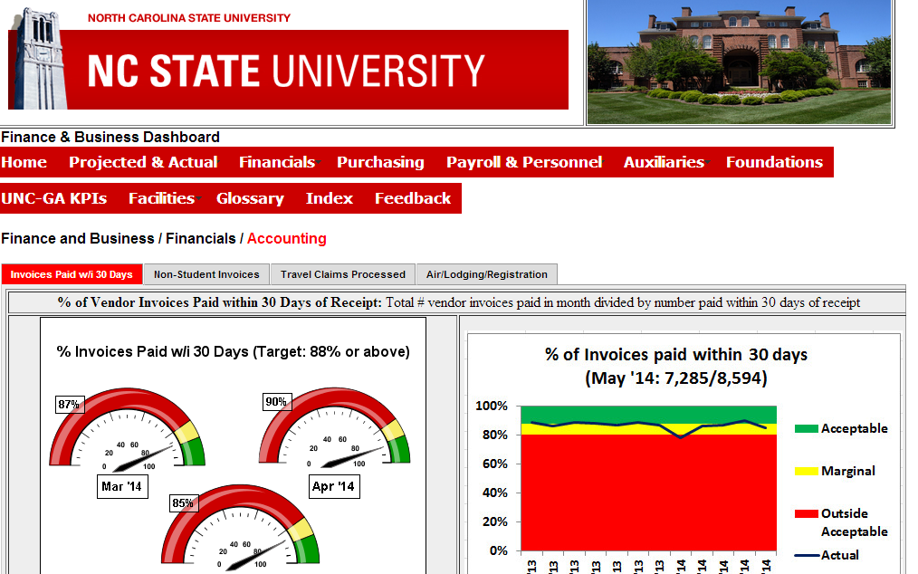
UNC FIT
Key Performance Indicators
Source: Finance & Business Dashboard. http://dashboard.ofb.ncsu.edu/
Notes:
Key Performance Indicators are highlighted on the Finance & Business Dashboard, menu option UNC GA KPIs.
Key Performance Indicators (KPIs) also included in UNC FIT system dashboard and sent to each Chancellor quarterly.
NC State submits 1,005 KPIs annually
How used?
Used by external entities for accountability of each UNC institution.
Used as a measure when budget reductions are allocated amongst institutions in the UNC system.

Slide 17
UNC-BOG’s Our Time, Our Future
Source: http://www.northcarolina.edu/sites/default/files/strategic_directions_2013-2018_brochure.pdf
Notes:
UNC’s strategic plan goal 4: Maximizing Efficiencies
Link in ALM data sheet.

Slide 18
UNC-BOG’s Our Time, Our Future
Goal 4: Maximizing Efficiencies
Create operational efficiencies through centralization
Create incentives for campus efficiencies through performance funding
Develop system-wide guidelines for academic productivity
Collect better, more comprehensive data
Source: http://www.northcarolina.edu/sites/default/files/strategic_directions_2013-2018_brochure.pdf
Notes:
UNC’s strategic plan goal 4: Maximizing Efficiencies
“UNC will make every effort to streamline operations and focus resources on our core mission of teaching, research and scholarship, and public service.”
Key strategies
Create operational efficiencies through centralization
Create incentives for campus efficiencies through performance funding
Develop system-wide guidelines for academic productivity
Collect better, more comprehensive data
Looks at both academic and administrative efficiency
Link in ALM data sheet.

Slide 19
UNC-BOG Efficiency & Effectiveness Metrics
Operating Metrics
Education and Related spending per degree*
UNC Compliance Index (UNC FIT)*
Support Spending per Student
Space Utilization: Average weekly use of student stations
Financial Stability: Private Fundraising Index
Academic Metrics
Six-Year Graduation Rate*
Freshman-to-Sophomore Retention Rate*
Degrees Granted to Pell Grant Recipients*
Degree Efficiency*
Attempted Hours to Degree
* Metrics currently in use.
Source: UNC General Administration
Notes:
BOG approved metrics.
Descriptions and standards of success are on ALM data sheet.
(Still discussing standards of success.)
In process of recalculating how we compare so don’t have that to share.
* Denotes metrics currently in use.
[Amy to add to talking points.]
Operating Metrics
Spending: Education and related spending per degree*
UNC Compliance Index*
Support Spending per Student
Space Utilization: Average weekly use of student stations
Financial Stability: Private Fundraising Index
Academic Metrics
Six-Year Graduation Rate*
Freshman-to-Sophomore Retention Rate*
Degrees Granted to Pell Grant Recipients*
Degree Efficiency*
Attempted Hours to Degree

Slide 20
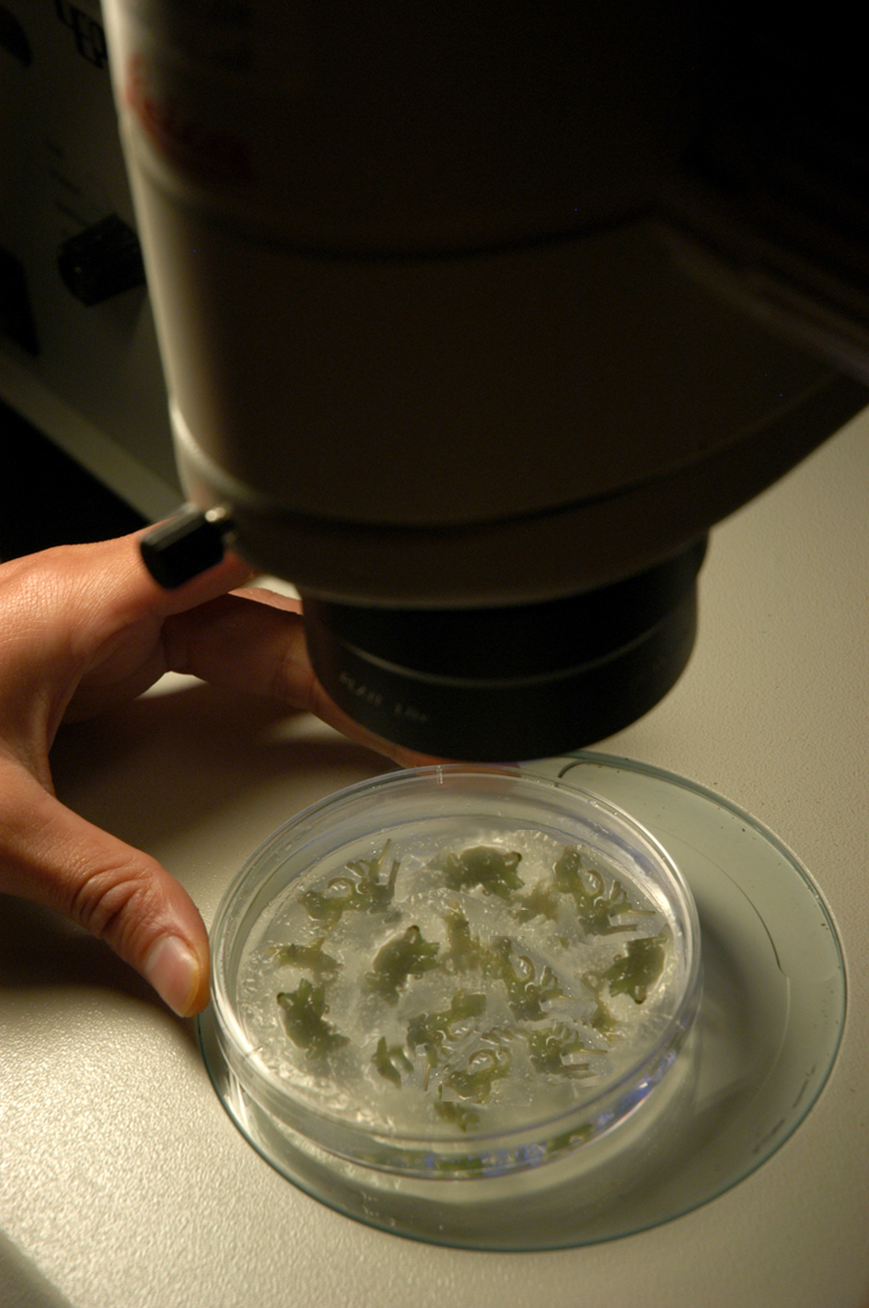
Notes:
In other words, we are under the microscope and will continue to be.

Slide 21
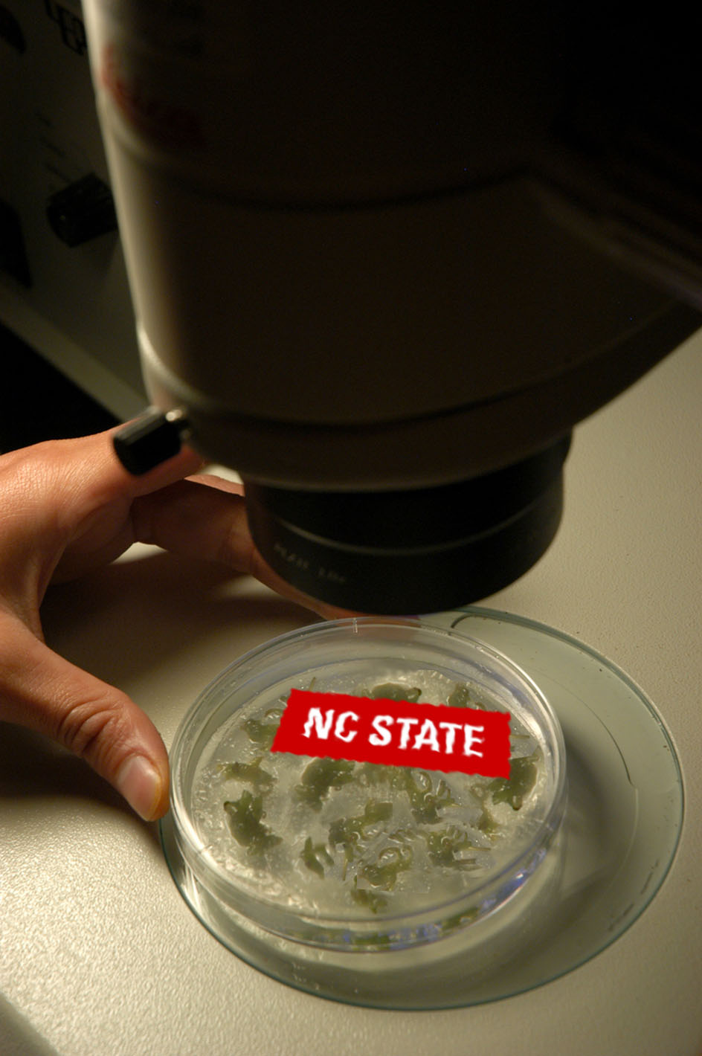
Notes:
In other words, we are under the microscope and will continue to be.

Slide 22
FOCUSING ON OURSELVES
Notes:
Examining ourselves

Slide 23
Recurring Efficiency Themes
Purchasing Efficiencies
Eliminate Redundancies / Create Shared Services
Consolidate IT Infrastructure
Implement Enterprise Systems (PeopleSoft)
Focus on Energy Reduction
Improve Space Management
Apply Metrics to Most Everything
Notes:
Recurring Efficiency Themes have typically included:
Purchasing Efficiencies
Eliminate Redundancies/Shared Services
Consolidate IT infrastructure
Implement Enterprise Systems (PeopleSoft)
Focus on Energy Reduction
Improve Space Management
Apply Metrics to Most Everything
NC State has gone beyond that in many ways.

Slide 24
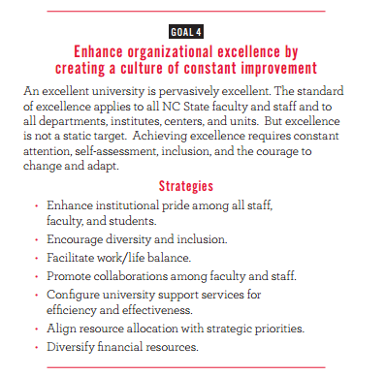
NC State’s Strategic Plan
Notes:
Other strategies in goal 4 – not meant to include all, but focusing on administrative operations.

Slide 25
Align Resources with Strategic Priorities: Organizational
Progress
Realignment Initiatives
Consolidation of Investment Management
Office for Information Technology
Campus Enterprises
Economic Development
Division of Academic and Student Affairs
College of Sciences
Challenges/Opportunities
Best strategic decisions may need investment, not necessarily cost reducing or cost neutral
Thinking at the university level, not departmental or divisional
Notes:
Success Highlights
Major Realignment Initiatives
Consolidation of Investment Management
Created Office for Information Technology by merger of Academic and Admin IT
Campus Enterprises service integration – Merged event, retailing and hospitality units
Merged Divisions of Undergrad Academic Programs and Student Affairs
Reconfigured College of Sciences
Challenges
Best strategic decisions not necessarily cost reducing or neutral
Right balance – restructuring can mean adding or reducing staff. Challenge of operating too leanly
Thinking at the university level, not departmental or divisional

Slide 26
Align Resources with Strategic Priorities: Fiscal
Progress
Budget Restructuring Task Force
Strategic Resource Management
Diversifying financial resources
Challenges/Opportunities
Budget restructuring will be gradual adjustment for long term impact
Alternate resources may need years before having budgetary impact
Notes:
Success Highlights
Budget Restructuring Task Force – evaluate best way to align budget with strategic priorities
Completed existing resource allocation process review, providing documentation to campus
Completed University-level enrollment model analysis, and conducting base resource analysis with selected peer institutions
Strategic Resource Management Working Group
Diversifying financial resources
1st year combined assets under management exceeded $1 billion
Total endowment grew 21.1% ($635.3 to $769.4M)
Challenges
Budget restructuring will be gradual adjustment for longterm, not near term impact
Endowment needs years of continued growth before budgetary impact

Slide 27
Align Resources with Strategic Priorities: Space
Progress
University Space Principles updated for better utilization of classrooms
Space Planning Team completed analysis of inventory.
Tagging people to space
Completing office space, working on research space
Transitioned data for 1,400 buildings and 40,000 rooms to new software system
Challenges/Opportunities
Thinking about class schedules differently
Source: Facilities Division.
Notes:
Success Highlights
University Space Principles updated for better utilization of 110 classrooms.
Space Planning Team: Completed 16 studies, 17 planning projects, 21 space requests, 14 information items.
Tagging people to space: Completing office space, working on research space.
Integrating two software systems: Transitioned data for 1,400 buildings and 40,000 rooms to new system.

Slide 28
Configure University Services for Efficiency and Effectiveness:
Shared Services
Progress
Onboarding Center
CALS Business Operations Pilot
Challenges/Opportunities
Finding right mix of shared services
Modifying systems to compliment business support
Launching online professional development for faculty and staff
Notes:
Success Highlights
Onboarding Center
Buddy for new hires: mentoring by employee in college/division for first few months
Improved accuracy:
Onboarding promotes earlier entry > Success rate of entering hiring actions up 7%
Onboarding W2 assistance > 79% more employees consent to online W2 (saving cost on printing, mailing, updating addresses for returns, etc.)
Increased compliance: I9, manager’s safety checklist, conflict of interest
In first 7 months (end of FY), served more than 2100 new hires from 348 departments, allowing colleges/departments to reduce administrative burden.
CALS Business Operations
Collaboration between UBOD and CALS
Completed ScottMadden CALS Business Center Study
Currently working on organization and staffing, process redesign and documentation, budgetary best practices and facilities and technology needs assessment.
Challenges/Opportunities
Finding right mix of shared services for NC State
Change is hard
Travel Center

Slide 29
Configure University Services for Efficiency and Effectiveness: Administrative Process Improvement
Progress
Facilities Modification Overhaul
Electronic Document Management
MarketPlace Expansion
Travel Portal
PI Portal
Challenges/Opportunities
Staying focused on high impact ideas
Collecting and communicating improvements
Notes:
Success Highlights
Facilities Modification
Because of identifying pain points and evaluating process, new Project Manager to offer better customer service and be one point of contact for facilities modification clients.
Document processing - Identified opportunities for process improvement in Controller’s Office, moving from document-based to online
Challenges
Not knowing how the Committee can assist with process evaluation and improvement
Communication campaign in fall 2014
Those items on to do list that keep getting pushed off because of other priorities – ask APRC for help and they can help facilitate

Slide 30
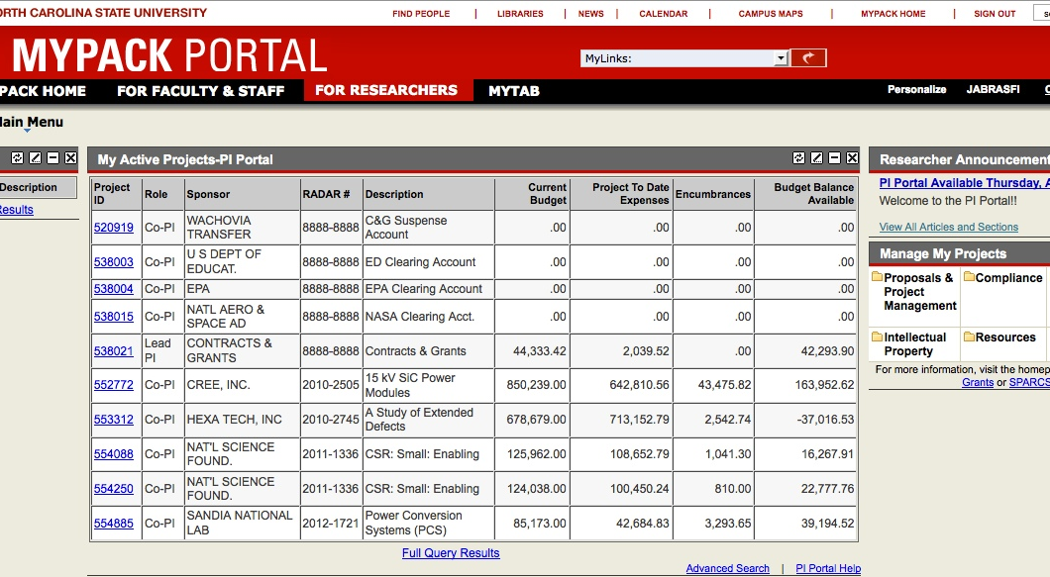
Configure University Services for Efficiency and Effectiveness:
PI Portal
Notes:
PI Portal (Office of Contracts & Grants)
On MyPack Portal for PIs
Benefits for researchers
Reduce administrative / time to track down information
All grants and related information in one place
Can track items across multiple grants (e.g., employees paid off of different grants)
Additional faculty-recommended enhancements and input from University Research Council
Features for salary detail, cost share, equipment search function, NSF and NIH salary cap compliance tools, new Project Management Request system and integration of all Project Modification Request

Slide 31
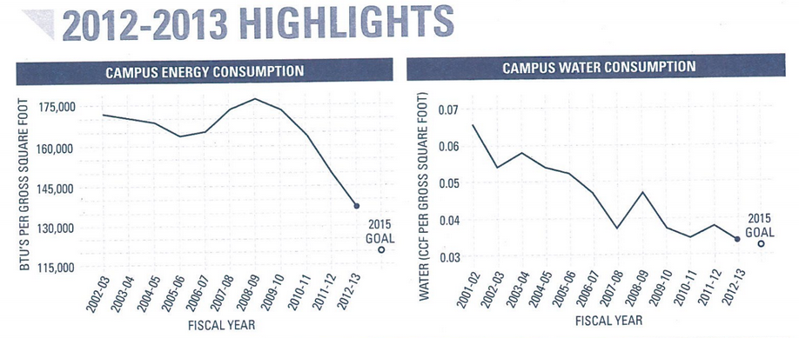
Configure University Services for Efficiency and Effectiveness:
Energy and Sustainability
Progress
Energy consumption down 23% since 2009
Performance Contracting Projects
Co-Generation
2012-13 Highlights
Notes:
Energy and Sustainability
Specialized Strategic Plans in support of University's Strategic Plan (i.e., Sustainability Strategic Plan, Energy Management Strategic Plan)
Energy and water consumption reduction from Sustainability Annual Report, also on F&B Dashboard
23% consumption reduction since 2009 (9.2% in past year) because of targeted energy performance contracting efforts
Installed a Combined Heat and Power (CHP) system at the Cates Utility Plant. The CHP system, also called cogeneration, is expected to pay for itself over a 17 year span. It reduced energy costs by more than $4 million in the first year alone.
A solar thermal system was installed on the roof of the Carmichael Gymnasium. The system features 112 solar panels and heats potable water for showers and locker room use.
Organized and implemented the Phytotron self performance enegy conservation measures contract.
Utility cost per student down 3.3% to $951
Saved $288,000 in utility costs via winter break energy setbacks
Challenges
When make such dramatic improvements, increasingly hard to make dramatic improvements

Slide 32
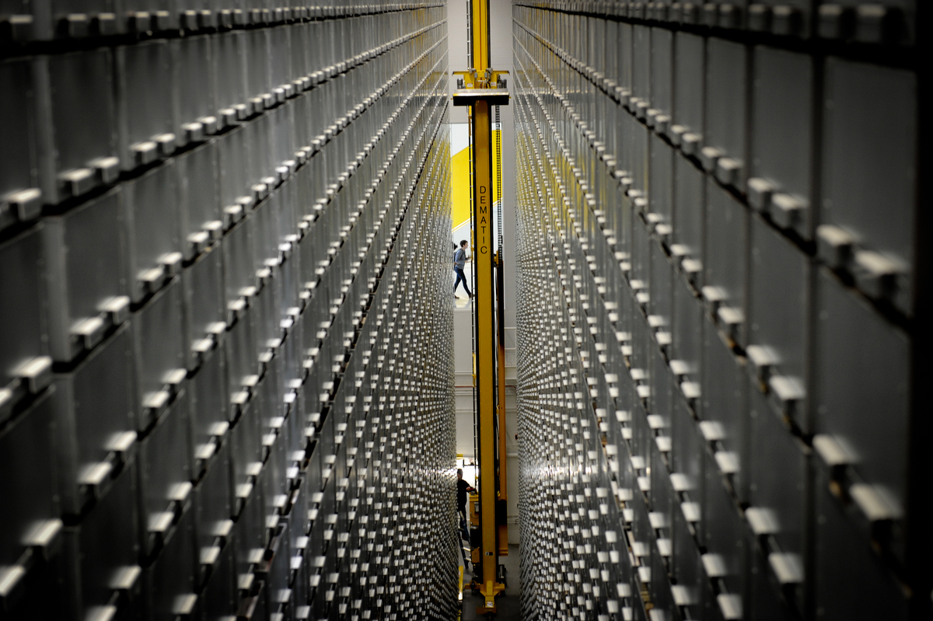
Notes:
Photo of bookbot – Illustrates that we have to think drastically differently about how we’ve always done things.

Slide 33
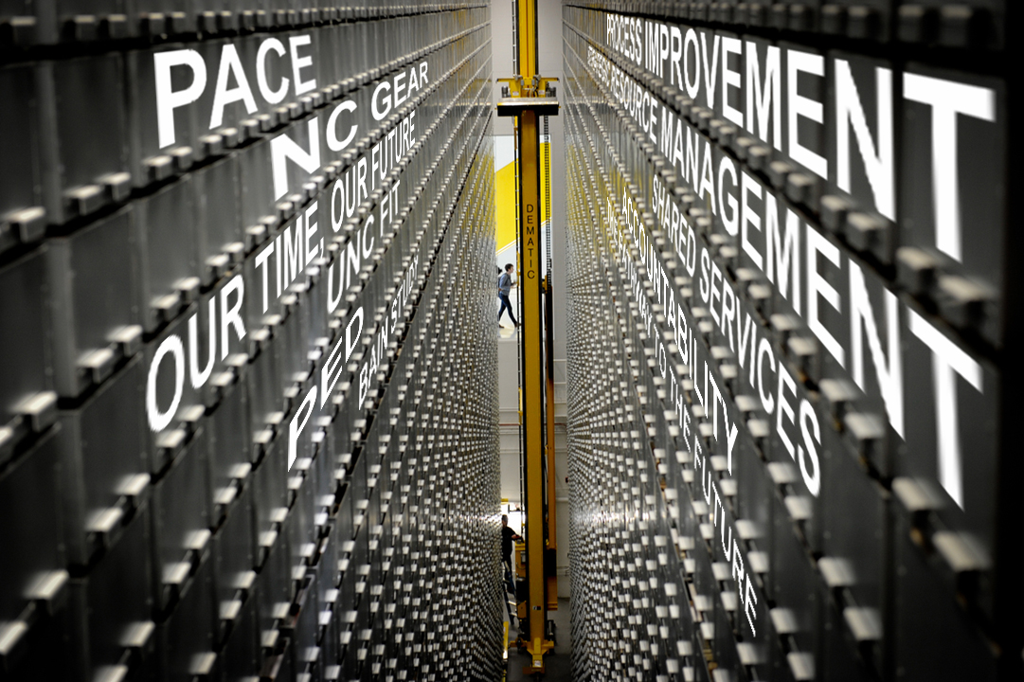
Notes:
Constantly overlay what we’re doing with the expectations

Slide 34
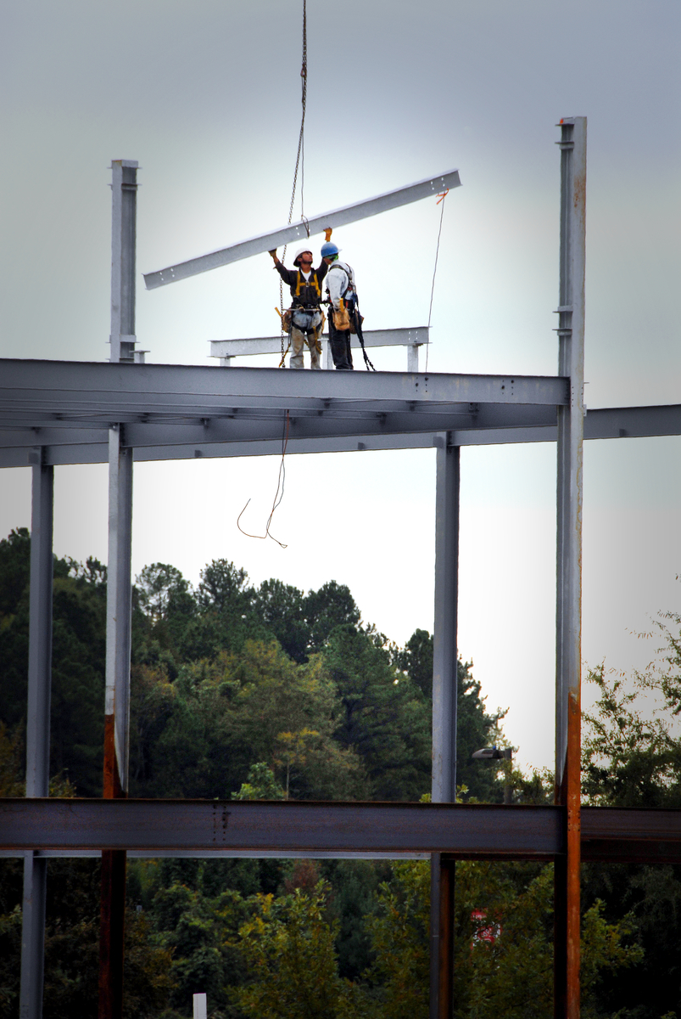
Strategic Resource Management
Campus shared nearly 200 ideas
First set of recommendations approved in May 2014
Communicated to campus May 28, 2014
Second set of recommendations in July 2014
Next update to campus in August 2014
Notes:
[Chancellor picks up with this slide.]
Strategic Resource Management Initiative one of ways we’re thinking differently.
Building to achieve new heights (photo tie-in)
Campus submitted nearly 200 ideas
Working group vetted and made first set of recommendations
Common Allocation Method for Enrollment-related Academic Funds
Doctoral Enrollment Growth
Internal Transfers
Differential/Premium Tuition and Fees
Many of these are building blocks to better management of resources
Chancellor accepted first set and communicated to campus May 28, 2014
Will receive second set of recommendations later this month, will review
Look to hear more about this second set in August

Slide 35
Recurring Efficiency Themes
Theme | Progress Made | Additional Opportunities
Purchasing Efficiencies | √ | √
Eliminate Redundancies / Create Shared Services | √ | √
Consolidate IT Infrastructure | √ | √
Implement Enterprise Systems | √ | √
Focus on Energy Reduction | √ | √
Improve Space Management | √ | √
Apply Metrics to Most Everything | √ | √
Notes:
Recurring Efficiency Themes have typically included:
Purchasing Efficiencies
Eliminate Redundancies/Shared Services
Consolidate IT infrastructure
Implement Enterprise Systems (ERP)
Focus on Energy Reduction
Improve Space Management
Apply Metrics to Most Everything
NC State has gone beyond that in many ways.

Slide 36
Recurring Efficiency Themes
Theme | Progress Made | Additional Opportunities
Purchasing Efficiencies | √ | √
Eliminate Redundancies / Create Shared Services | √ | √
Consolidate IT Infrastructure | √ | √
Implement Enterprise Systems | √ | √
Focus on Energy Reduction | √ | √
Improve Space Management | √ | √
Apply Metrics to Most Everything | √ | √
Communicate / Promote Successes |  | √
Notes:
Biggest opportunity is to communicate and promote successes.

Slide 37
Culture of Constant Improvement
Evaluate
Measure
Improve
Notes:
Improvement is continuous process
Cyclical nature of constant improvement
Evaluate opportunities
Measure progress
Improve

Slide 38
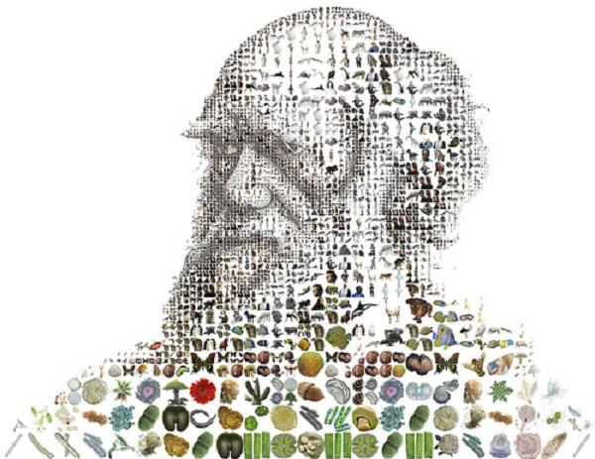
"It is not the strongest of the species that survives, nor the most intelligent, but the one most responsive to
change.” – Charles Darwin
Source: http://elitechoice.org/2009/11/24/charles-darwins-first-edition-of-the-origin-of-the-species-discovered-on-a-dusty-bookshelf/

